Slide 1
Spotify CS Forecast
Forecast for customer service email volume at the daily level from June 1st , 2021until December 31st, 2021.

Slide 2
The Premise
Using the dataset provided, we’d like you to build a forecast for customer service email volume at the daily level until December 31, 2021.
The purpose of the forecast will be used to determine our daily customer service staffing needs based on the email volume of the day.
What makes this a robust model?
Is there seasonality in the model?
Are there specific dates or holidays where we expect to see unusual behavior?

Slide 3
The Data
A general overview of the raw data provided

Slide 4
Data Overview
Column name | Description
date | Date
email | Number of emails, i.e. email volume
subs | Number of total subscribed users
subs_standard | Number of subscribed users on the standard product, i.e. $9.99 Premium subscription
subs_student | Number of subscribed users on student subscriptions
subs_family | Number of subscribed users on family subscriptions
f_subs | Forecast of total subscribed users
f_subs_standard | Forecast of subscribed users on the standard product
f_subs_student | Forecast of subscribed users on student subscriptions
f_subs_family | Forecast of subscribed users on family subscriptions
mau | Number of Monthly Active Users, i.e. users that have a stream in the last 30 days
f_mau | Forecast of Monthly Active Users.
There are a total of 12 features. One date, and six that represent historical values.
The remaining five represent forecasted values from April 1st, 2021, to the end of 2021.
There are no missing values in our historical data that need to be accounted for with methods such as imputation.
There is two years and five months of historical data available to help inform modeling efforts.

Slide 5
Time Series Visuals
A visual inspection of time series characteristics

Slide 6
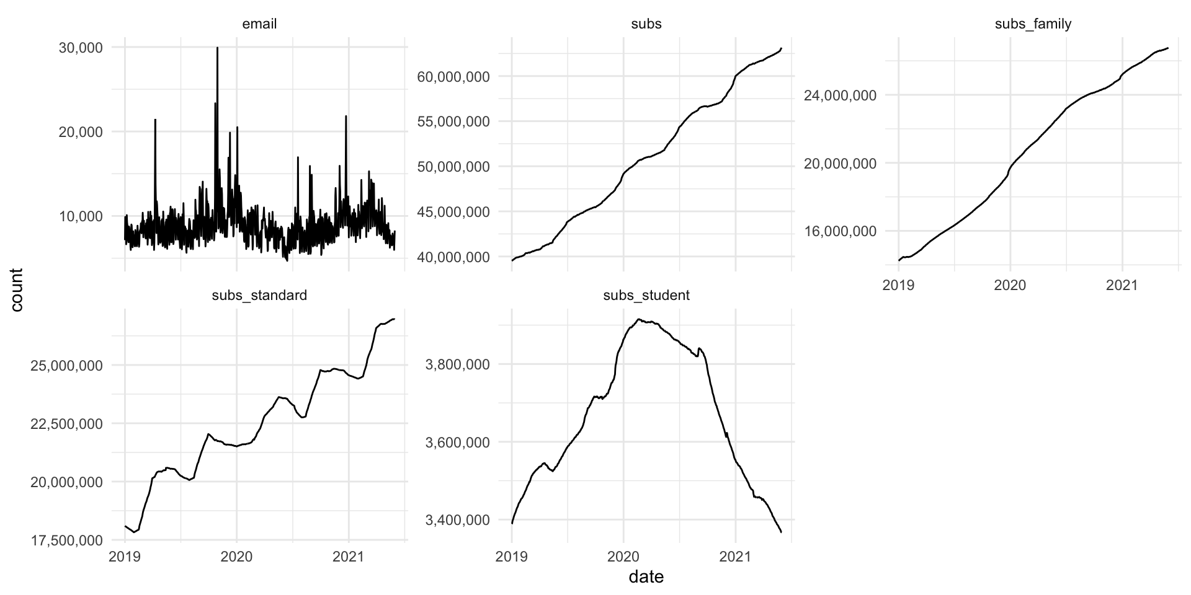
Historical values
Email volume is stationary with no strong trend
Subscriber volume has a very strong growth trend with mild monthly seasonality
Standard volume is also heavily trended with more pronounced monthly seasonality
Student volume grows from 2019 to early 2020 then declines rapidly toward

Slide 7
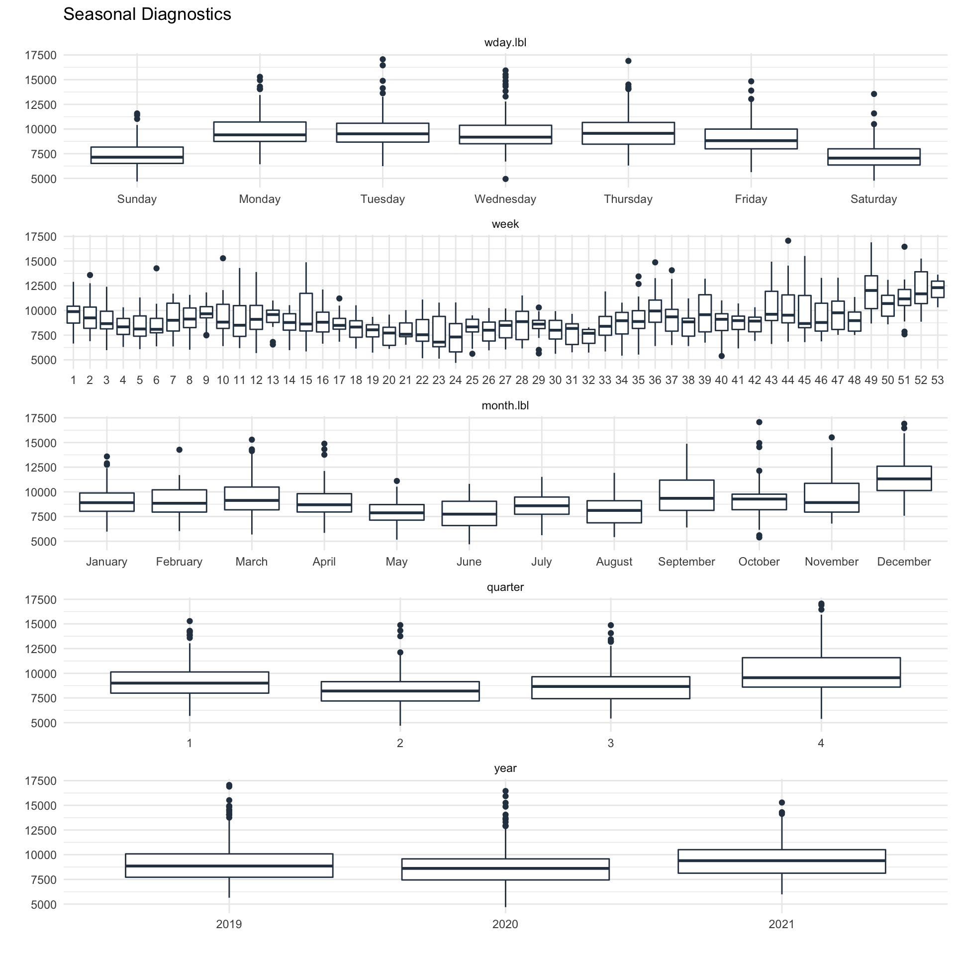
Seasonal diagnostics
Here we’ll isolate email volume
There is a daily seasonal pattern with low volumes on weekend and high volumes on weekdays
There also seems to be mild seasonality on a per week level
Month, Quarter and Yearly aggregates do not have overt seasonal characteristics

Slide 8
Email volume
Email volume is stationary with no strong trend
There do seem to be anomalies present for example April 10th, 2019, and October 23rd and 30th that exhibit volume well over 20K
The anomalies don’t have a recurring pattern and a forecast process may benefit from removing these anomalies

Slide 9
Zoom in
From afar the work week seasonal pattern isn’t apparent
If we zoom in, we can see that there is a strong pattern
This pattern generally exhibits lower volume on weekends compared to weekdays

Slide 10
Anomaly diagnostics
Decomposition of the time series allows for removal of both trend and seasonal components
The remainder is used for anomaly detection
An inner quartile range is established with respect to the median and then expanded to define boundaries
Anomalies are marked in red

Slide 11
Remove anomalies
Anomalies are systematically removed from the series
Values are now more stable and don’t pass the 17K mark
This time series will be suitable for forecasting as the effects of outlier's won't misinform the forecast model

Slide 12
Forecast models
An overview of the forecast process

Slide 13
Many models
Type | Model
Time series | ARIMA
Time series w/ ML | ARIMA W/ XGBOOST ERRORS
Time series | ETS
Time series | PROPHET
ML | LM
For this exercise five time series models are developed on a training data set
Univariate with respect to email volume and date
The models are a mixture of “classical time series” methods such as ARIMA and methods aligned more so to a supervised machine learning approach
All models were evaluated on testing data

Slide 14
Forecast vs Actual
A model is developed for each respective method on training data
Each model then forecasts on the testing data and errors are evaluated
The forecast is overlay on the actuals for closer visual inspection of performance
All models have wide confidence intervals and don’t seem to capture the decreasing trend beginning approximately April 2021.
Both ARIMA models capture the weekly patterns well and deviate the least in the period after April 2021.

Slide 15
A closer look at two potential models
ARIMA w/ XGboost
ETS

Slide 16
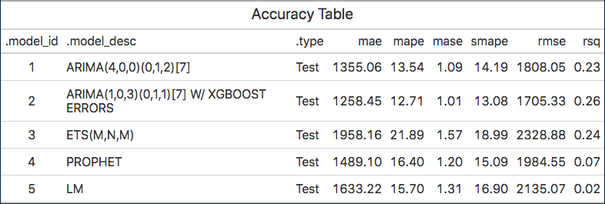
Accuracy summary
The ARIMA XGBoost model has the lowest MAE and highest r-squared value
Both ARIMA models confirm and account for seasonality

Slide 17
Forecast forward
Each of the five models is refit on the entire data set and then used to forecast ahead seven months by day
All models except for our linear models capture the weekly pattern of email volume well and provide reasonable forecasts
There are now five options to choose from
Choose a model considering both accuracy, interpretability, and computational cost

Slide 18
A closer look at two potential forecasts
ARIMA w/ XGboost
ARIMA

Slide 19
Next steps
Further considerations with respect to model development and inference

Slide 20
Regression model
As an example, we’ll assume that a consensus has been made to explore the regression model further.
To do this the model is isolated and further developed by adding features such as nominal day of week and holiday(s).
From this we can view our model coefficients for a preliminary confirmation of seasonal effects, as well as those of holidays.

Slide 21
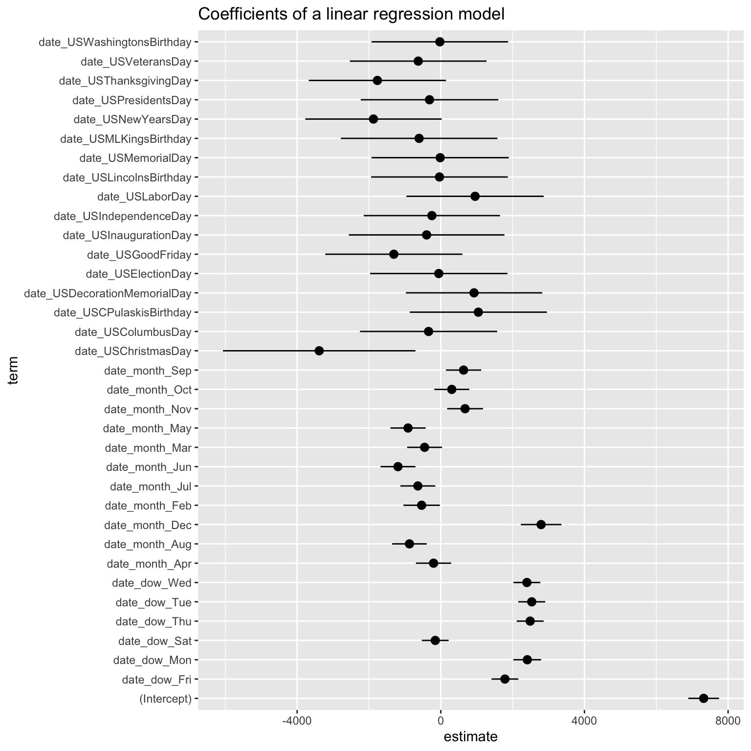
Model development
Using our enhanced regression model, we can now examine coefficients for inference.
For example, we can see that weekdays have a positive effect on email volume while weekends have a negative effect.
We can also see that holidays have varying effects, along with wide confidence bands.
Further examination of p-values can help us zero in on those holidays that may relavent

Slide 22
Conclusion
The enhanced regression model performs better than the previous regression model
Using our previous model as comparison we can see that our rmse has improved from a previous value of approximately 2130 down to about 1750, an 18% decrease
This improvement puts it in line with the best time series model, ARIMA Boost rmse of 1705, and improving r2 measures from .02 to .36
The model is robust to outliers since we removed them during model training and included additional features for day of week, month, and holidays
Both our ARIMA Boost model and enhanced linear model confirm weekly seasonality and use model parameters to extrapolate the pattern forward into future forecasts
Holiday effects aren’t statistically significant except for Christmas which has a negative effect on email volume, we can use this information to adjust our model

